Slide 1



Slide 2
The Recommendations System for Source Code Components Retrieval
PROJECT TITLE:-
MEMBERS:
Ayesha malik (12)
Ayesha javed(30)
Mahnoor altaf(44)
Kiran riasat(21)

Slide 3

THINGS TO DISCUSS
INTRODUCTION
PROBLEM STATEMENT
RESEARCH GAP
OBJECTIVE
SCOPE
CONCLUTION

Slide 4

introduction
During the last few decades, with the rise of You-tube, Amazon, Netflix and many other such web services, recommender systems have taken more and more place in our lives.
As We are developing a software, necessary to measure the reusability of component(source code) in order to realize the reuse of components effectively.
This recommendation system would provide ease for software developers in finding there relevant source codes with there reusability percentage according to the applied algorithms.
Implement the learning to rank techniques for code retrieval
Notes:
We define five metrics for measuring a component's understandability, adaptability, and portability, with confidence intervals that were set by statistical analysis of a number of JavaBeans components

Slide 5

introduction
This project will effectively cater the answers of given questions by ranking the best code systematically on the basics of programming techniques and algorithms:
Access the executable files and source code either it gives some productive impact or not?
which source code is the most relevant according to given query?
How much of the retrieved code would execute?
Notes:
The relationship between the complexity of a component and the
ease of reuse was analyzed by a regression analysis
In this study the relationship of reusability with complexity and
reuse design principles was reported. Thirty-four subjects
participated in the study with each subject reusing 5 components,
resulting in 170 cases of reuse. The components were randomly
assigned to the subjects from a pool of 25 components which were
designed and built for reuse.
The relationship between the complexity of a component and the
ease of reuse was analyzed by a regression analysis. It was
observed that the higher the complexity the lower the ease of
reuse, but the relationship was not statistically significant. An
analysis of the relationship between a set of reuse design
principles and the ease of reuse was also reported. Two of the
three reuse design principles: well-defined interface, and clarity
and understandability significantly increased the ease of reuse
while documentation does not have a significant impact on the
ease of reuse

Slide 6


Problem Statement
Finding reusable software components from online repositories and integrating them to the source code, is the most tiring work for software developers.
The software's Functional and Non-Functional requirements doesn’t meets the developer’s requirements every time.

Slide 7

solution
Our recommended system proposed a code example by provide search facilities and learningto-rank techniques.
Better performance of our approach using the learning-to-rank technique can help code search engines place effective code examples at the top of result.
This system rank the codes and researches based on their reusability criteria.
Provides the reusability scores of the found results.

Slide 8
solution
We purpose a solution that makes code search concise and precise as much as possible.
Facilitate the user with various retrieval method, out of which they can select the one they deem fit for their purpose.

Slide 9

Research Gap
Google search tool provides the facility to users to search the code by language , package name , files name and types
of files. But the size of repository and the rankling algorithms are not published.
Our primary focus is on to relate the large scale of code usability and we estimate this by calculating the fraction point of code that are appearing in many projects.
(Audris Mockus Avaya Labs Research 233 Mt Airy Rd, Basking Ridge, NJ 07901 audris@avaya.com)
Reference

Slide 10

Objective
By examining all the research gaps and the problem statement, we have set following objectives:
To identify the issues related to the search and the retrieval of the components faced by the users.
To develop a software which extract the source code, documentation and all executable and reusable file and stored in local repository for ranking.
To make Efficient retrieval of Source code on the basis of precision and recall.

Slide 11
Methadologies
web crawling
Tokenization and store the token in database
Match with the repository
Rank the code
Recommend the result to the user

Slide 12

Scope
This project aims to provide ease to the software developers to do the online source code repositories and question answering communities.
The proposed solution facilitates the task of ﬁnding suitable (with respect to a developer query) source code according to given information.
It help the users to get personalized recommendations, helps users to take correct decisions during development process,
The project’s main aim is to provide accurate source_code recommendations to the user(developer). Finding and locating the desired code component consumes less time and effort.

Slide 13

FUTURE WORK
This Project would be divided into 2 further modules
Web based application in visual studio(Asp.net).
Desktop Based Application on visual studio(C#).
More learning to rank techniques are used.
Different training Datasets are used.

Slide 14
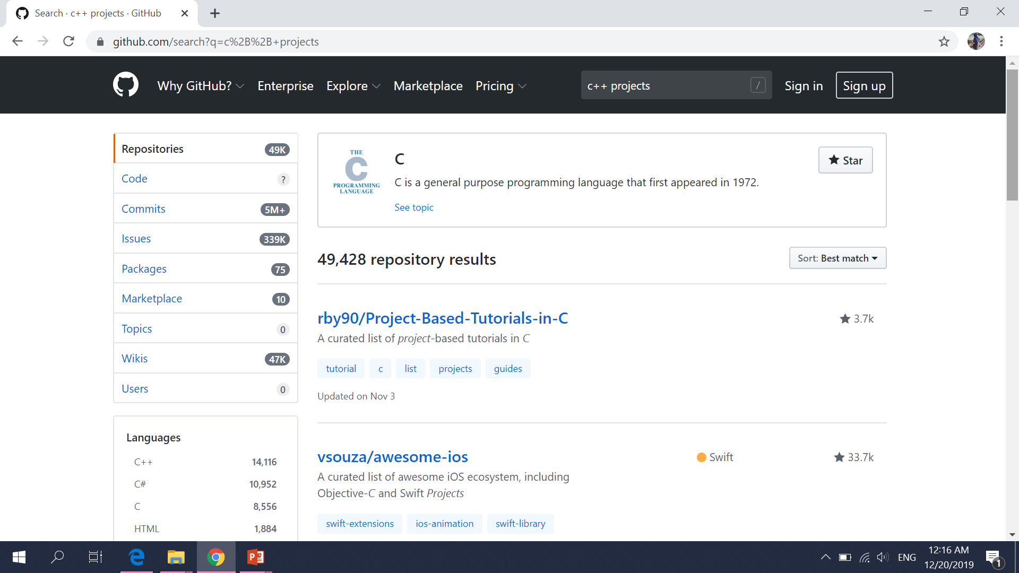

Slide 15
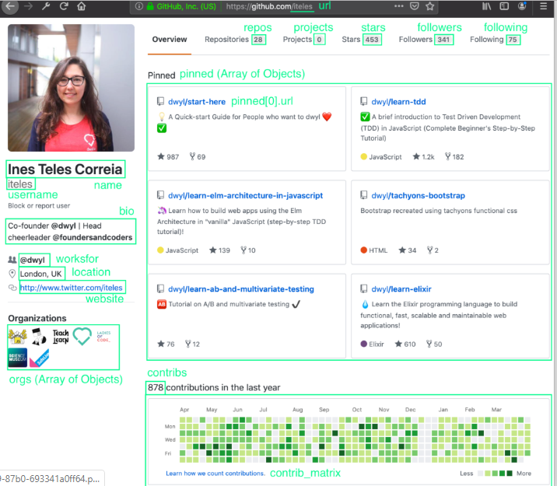

Slide 16
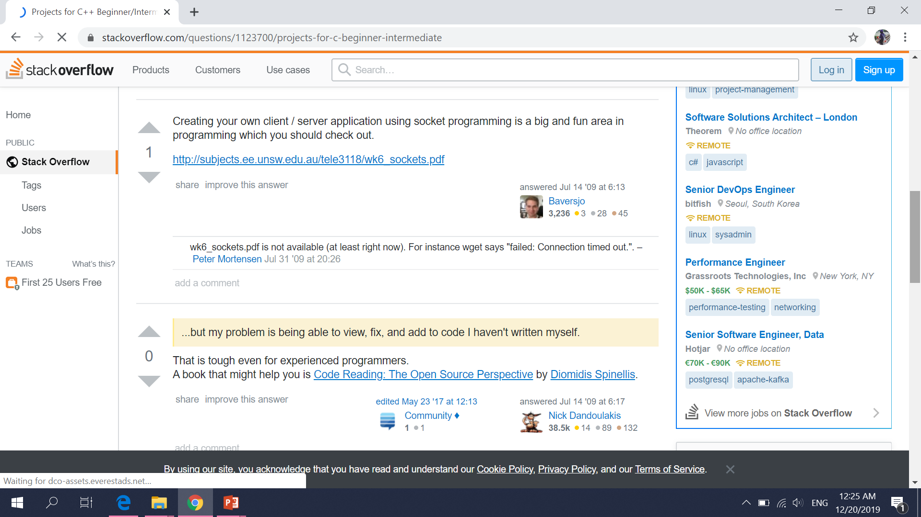

Slide 17
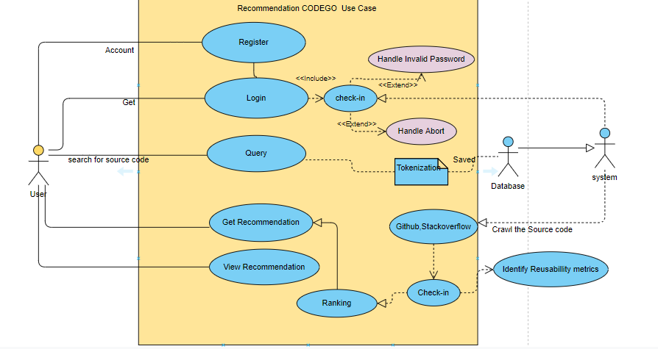
IMPLEMENTATION
Figure 1 presents the working system that implements as proof of our proposed approach.

Slide 18

Thank you

